Slide 1








Instrumentation & Measurements for Smart Industry
Anno Accademico 2021-2022
Prof. Pasquale Arpaia
Instrumentation & Measurements 4 Smart Industry, AA 2021-2022 – Prof. Pasquale Arpaia

Slide 2
OUTLINE
CONDUTTIMETRIA
IL PROBLEMA
L’IDEA
MISURA DI IMPEDENZA
SPETTROSCOPIA DI IMPEDENZA
CARATTERISTICHE METROLOGICHE

Slide 3
Conduttimetria

Slide 4
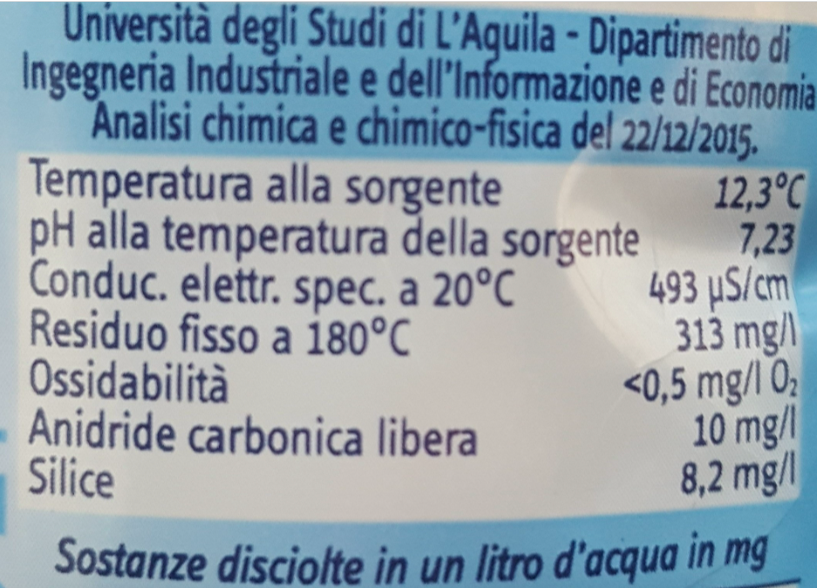
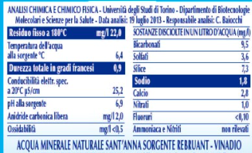
Acqua San Benedetto 2 euro
Acqua Sant’Anna 4 euro

Slide 5
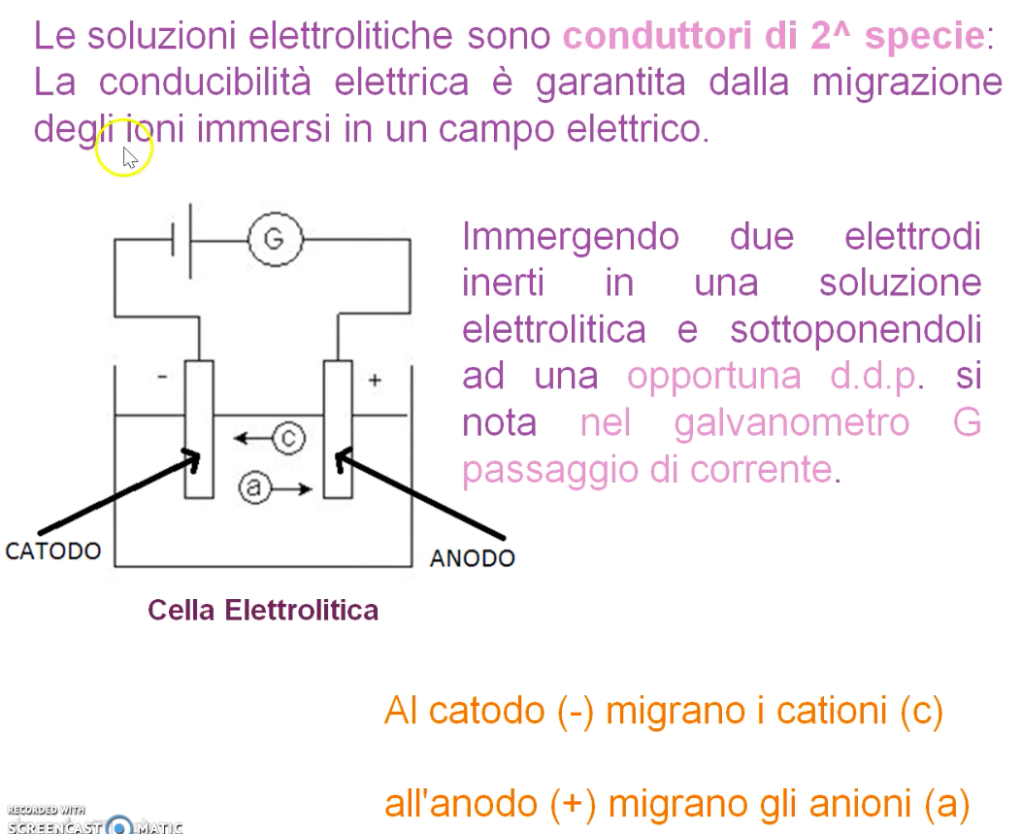


Slide 6
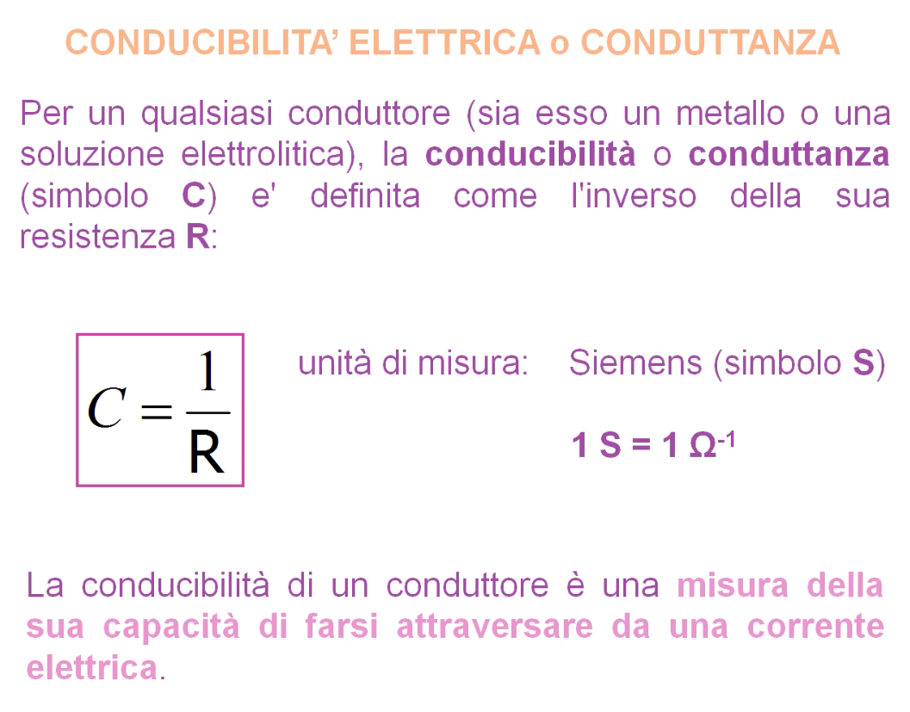

Slide 8
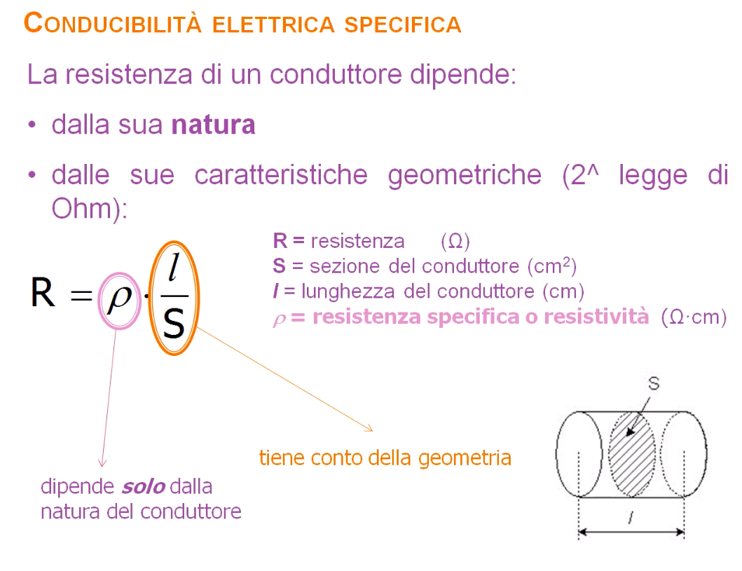

Slide 9
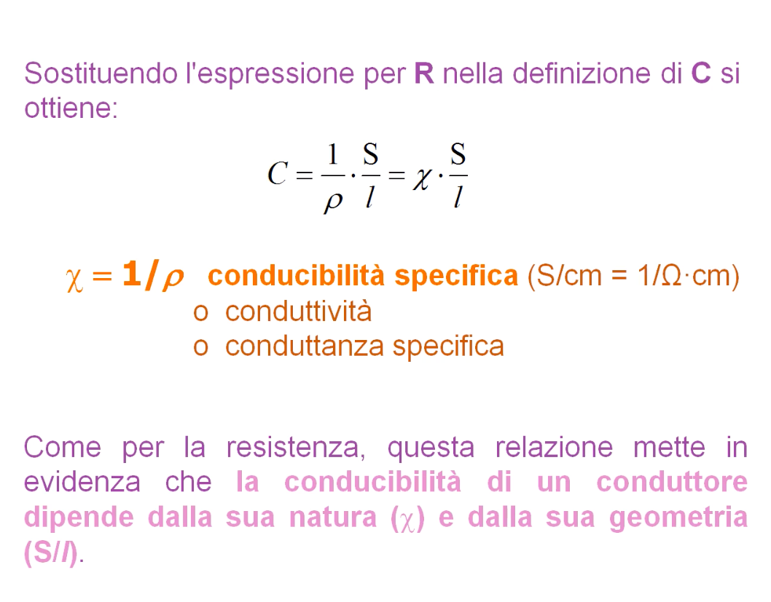

Slide 10
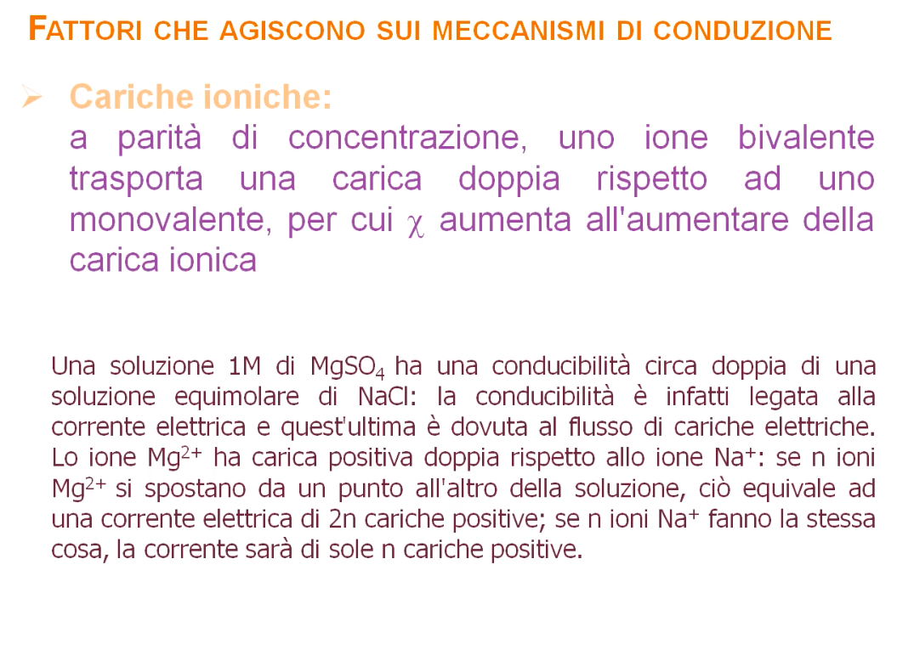

Slide 11
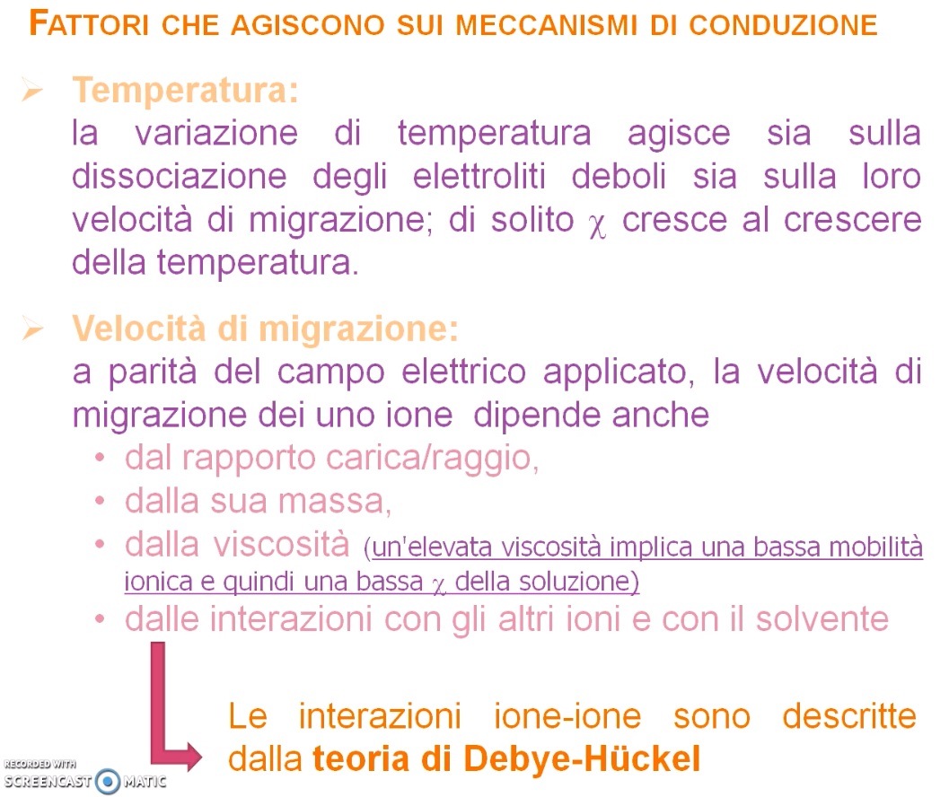

Slide 12
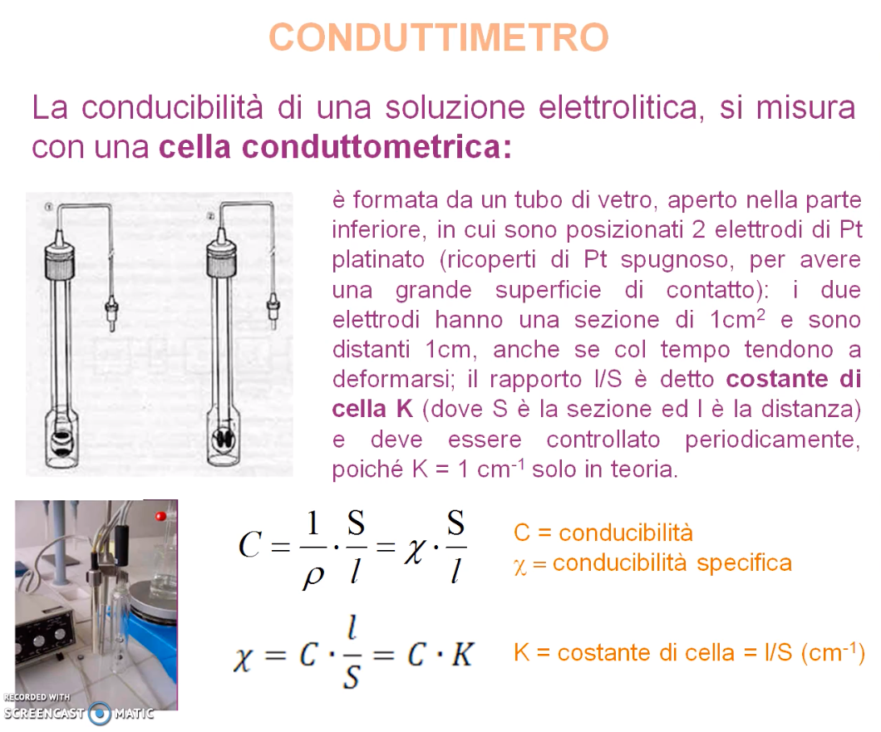

Slide 13
Il problema

Slide 14
Context
Number of people with diabetes in the world: 400 million
Diabet is the fifth leading cause of death in most developed countries
Type 1 diabetic patients need regulating blood glucose concentration (BGC)
Current insulin treatment strategies are:
multiple daily insulin injections
insulin pump.
Artificial Pancreas (AP): An emerging treatment to improve the BGC regulation
Notes:
Diabetes is one of the most spread non-communicable diseases worldwide. Globally, the number of people with diabetes is currently around 400 million and this disease is the fifth leading cause of death in most developed countries, according to international diabetes federation. Diabetes costs affect health services and national productivity, as well as individuals and families. Its financial burden has a relevant impact on the economy of the society. For type 1 diabetic patients, the monitoring of blood glucose concentration (BGC) and its regulation are crucial issues. The current insulin treatment strategies consist of either multiple daily insulin injections or continuous subcutaneous insulin infusion with an insulin pump. Moreover, people with diabetes usually use painful and time-consuming tests like pricking finger to obtain capillary blood samples.An emerging treatment to improve the BGC regulation is the artificial pancreas (AP), also referred to “closed loop glucose control”

Slide 15
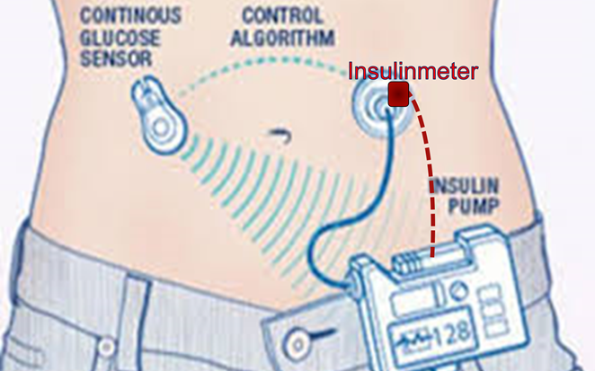
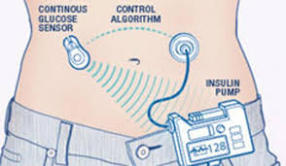
Open problems - 1
Artificial Pancreas (AP): a closed-loop control of blood glucose in diabetes
The loop is closed in case of basal insulin administration (i.e. long term, e.g. daily).
At each meal, when food is ingested, further insulin is administered specifically (Bolus).
Even most recent systems cannot react to such quick glucose swing.
Needs for new control inputs: e.g.,
insulin sensitivity factor (ISF)
and insulin duration of action. (IDA)
They are both fixed during Artificial Pancreas calibration.
Notes:
Artificial Pancreas consists of a glucose sensor control algorithms, and an insulin infusion device. The glucose sensor is necessary to monitor the variability over time of BGC, to adjust insulin dosage, and to measure the efficacy of therapy after administration. The loop is closed in case of basal insulin administration, meanwhile, in case of bolus administration, the system cannot react instantaneously to the quick BGC variation caused by food ingestion. Constant glucose monitoring is performed in the interstitial fluid, and, therefore, it is associated with a time delay implicit from plasma concentrations. In case of bolus administration, even the most recent automated systems cannot react to the quick variations of glucose due to food ingestion. The latency (average 6.8 minutes and up to almost 10 minutes) introduced by semi-noninvasive glucose meters involves the needs for new control inputs: Total Daily Dose of insulin (TDD), carbintake, basal/bolus ratio, basal segments, carbohydrate-to-insulin ratio (CIR), target range, insulin sensitivity factor (ISF), and insulin duration of action. They are both fixed during Artificial Pancreas calibration

Slide 16
Open Problems -2
ISF and IDA can be subject to significant variations depending on the kinetics of the insulin absorption (Bioavailability).
Inter- and intra-individual characteristics
Skin alteration such as lipo-hypertrophic nodules
To date, the main methods for assessing insulin bioavailability are invasive or have high latency
Notes:
Insulin sensitivity factor (ISF), and insulin duration of action. can be subject to relevant variations depending on the kinetics of the insulin absorption.Skin alterations, such as lipo-hypertrophic nodules, are the main causes of intra-individual variability in insulin absorption.Different classes of drugs used in insulin therapies have a delayed and variable absorption if injected into lipohypertrophic nodules. More generally, the presence of lipo-hypertrophic skin alterations is associated with poor metabolic control and considerable intra-individual glycemic instability. These problems affect also advanced automated diabetic therapy. An accurate insulin bolus administration is guaranteed by a real-time monitoring of the amount of insulin actually absorbed, namely bioavailable.
To date, main methods for assessing insulin bioavailability are enzyme-linked immunosorbent assay, radioimmunoassay,high-performance liquid chromatography, and Continuous Glucose Monitoring Sensors. Unfortunately, these methods areinvasive or have high latency

Slide 17
L’idea

Slide 18

Claims
Non-invasive and painless measurement method
A solution based on off-the-shelf components
Increased accuracy of automatic insulin pumps or artificial pancreas
Customization of diabetic therapy
Notes:
The claims of this study are: prototyping a solution based on off-the-shelf components for implementing a non invasive and painless measurement method. The goal is Improving accuracy of automatic insulin pumps or artificial pancreas and customization of diabetic therapy

Slide 19

Basic Ideas - 1
1. The insulin variation can be assessed non invasively by electrical impedance variation
After injection, the leakage of a given amount of insulin (ml), due to systemic absorption, produces a corresponding variation in the measured equivalent impedance in the administration volume.
Notes:
In previous works, the Authors demonstrated the feasibility of a method to measure the amount of drug administered transdermally by impedance spectroscopy. In this study the method was tested on insulin absorption. So a basic idea is After injection, the leakage of a given amount of insulin due to systemic absorption, produces a corresponding variation in the measured equivalent impedance in the administration volume.

Slide 20
Basic Ideas - 2
2. Personalized Medicine
During insulin administration,a model of insulin appearance for the individual subject in each his/her condition is identified (personalized medicine).
The model of insulin appearance can be used in absorption (disappearance) phase
Notes:
The second basic idea is: We use the injection phase to get information on the treated tissue. Drug administration in known doses by insulin pump allows to identify a specific personalized impedance-model for each tissue single condition. Increasing gradually the amount of drug while measuring impedance variations allows to build a relation specific for that tissue at that time. That is: an insulin appearance model. The insulin/impedance model can be employed during absorption measurement for assessing insulin disappearance, and thus bio-availability. This allows to improve significantly inter- and intra-individual reproducibility.

Slide 21
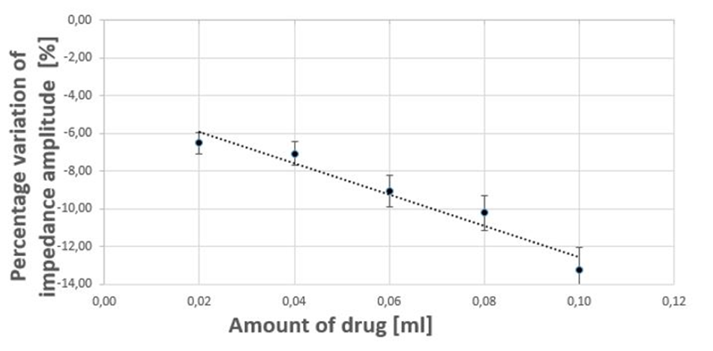
Personalized Model
Increasing gradually the amount of drug while measuring impedance variations, allows identifying a custom relation for the tissue under test.
Model of insulin appearance

Slide 22
Personalized Model
Inverse model of insulin appearance is used in the absorption (disappearance) phase
t= t₀
t= t₁ > t₀
Measured Impedance
Estimated amount of drug still not absorbed

Slide 23
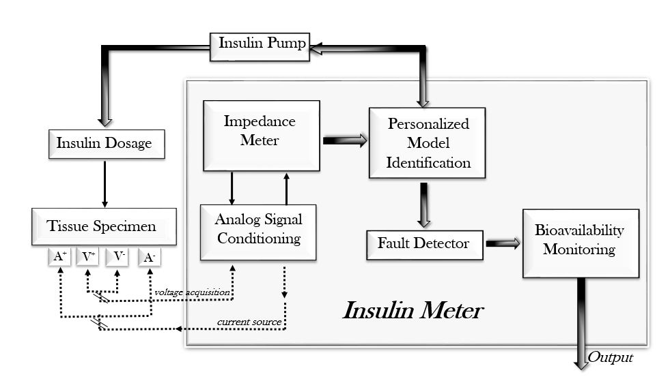
Architecture
Four Electrodes connected to the skin
Transducer measures the amount of insulin absorbed by the tissue assessing the impedance variation
Personalized Model Identification
Notes:
The architecture of the proposed insulin meter is shown in the picture. Four Electrodes are connected to the skin of the subject where the insulin was injected (Tissue Under Test). TheImpedance Meter sends a sinusoidal current stimulus with given amplitude and frequency through the amperometric electrodes, and takes the corresponding voltage drop through the voltage meters, through the Analog Signal Conditioning. The insulin is injected at known step by an Insulin Pump, and step by step the transducer measures the corresponding impedance. On this basis, the insulin meter carries out a Personalized ModelIdentification. Then, in the Fault Detector, the personalized model parameters identified experimentally during the injection are checked to fall within the uncertainty limits assessed by off-line metrological characterization. In positive case, the transducer is able to measure the amount of insulin absorbed by the tissue, through an assessment of the impedance variation. Finally, the bio-available insulin is assessed by difference, by monitoring the reduction of the initial amount over the time.

Slide 24
Realized Instrument
Insulinmeter is based on EVAL-ADUCM350 Evaluation Board of Analog Device
Battery
Doughterboard BIO3Z for 4-wire bioimpedance measurement
Notes:
The EVAL ADUCM350 EVALUATION BOARD is a motherboard, with a processor ARM Cortex-M3 at 16 MHz, equipped with an analog front-end.The motherboard has a 16-bit DAC to impose the sinusoidal input signal and a 16-bit to 160 kS/s ADC converter, capable of converting the detected current signal into a voltage signal. The motherboard is also able to perform a DFT on 2048 points calculating both the magnitude and the phase of the complex impedance. The transducer has a slot for the doughterboard of signal conditioning. At this aim, 4-wire measurements are carried out by adopting the doughterboard ” BIO3Z for 4-WireBio Impedance measuerement”.
The transducer has three power supply options: USB cable, battery, and 3.3 V via external transformer and wall socket.

Slide 25
Impedenza

Slide 26

L’energia elettrica può essere fornita in continua o in alternata.
Nel primo caso la tensione è costante, nel secondo caso è sinusoidale. Nelle nostre case l’energia elettrica arriva come segnale elettrico sinusoidale di valore efficace 220V di tensione e frequenza 50Hz (cioè 50 cicli al secondo, negli USA e in altri paesi 110V e 60Hz).
Si definisce il valor medio di un segnale periodico x(t) la quantità:
1
𝑇
𝑋 = _{𝑇} ∫ 𝑥 𝑡 𝑑𝑡
0
dove T è il periodo in secondi (può essere definito come il reciproco della
frequenza).
Si definisce valore efficace di un segnale periodico x(t) la quantità:
𝑇
1
2
𝑋 = _{𝑇} ∫ 𝑥 𝑡 𝑑𝑡
0
Fisicamente, il valore efficace di una grandezza equivale a quel valore che, in regime di
tensione continua, svilupperebbe la stessa potenza
183

Slide 27
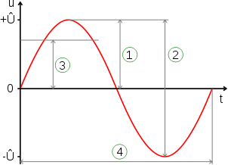
Consideriamo il seguente segnale sinusoidale
Definiamo:
tensione di picco
tensione picco picco
valore efficace
periodo

Slide 28






Definisco x(t) come un generico segnale sinusoidale:
𝑥 𝑡 = 𝑋_{𝑝} cos 𝜔𝑡 + 𝜑
con 𝑿_{𝒑} valore di picco (ampiezza della sinusoide), 𝑚 pulsazione (in radianti/sec), che si può ottenere dalla formula 𝜔 = 2𝜋𝑓 , con f frequenza (cicli/sec) e 𝝋 la fase.
Due segnali
𝑥 𝑡 = 𝑋_{𝑝} cos 𝜔𝑡 + 𝜑 e 𝑥₁ 𝑡 = 𝑋_{𝑝1} cos 𝜔𝑡 + 𝜑₁
(quindi con la stessa 𝜔 o frequenza) si dicono sfasati e la quantità
𝝋_{𝟏} − 𝝋_{𝟎} viene definita sfasamento di 𝑥₁(𝑡) rispetto a 𝑥₀(𝑡).
Se lo sfasamento è nullo, i due segnali si dicono in fase.

Slide 29






Definisco x(t) come un generico segnale sinusoidale:
𝑥 𝑡 = 𝑋_{𝑝} cos 𝜔𝑡 + 𝜑
con 𝑿_{𝒑} valore di picco (ampiezza della sinusoide), 𝑚 pulsazione (in radianti/sec), che si può ottenere dalla formula 𝜔 = 2𝜋𝑓 , con f frequenza (cicli/sec) e 𝝋 la fase.
Per un segnale sinusoidale 𝑥 𝑡 così definito si ha:
𝑋 = 0
𝑋 = ^{𝑋𝑝}/
2

Slide 30






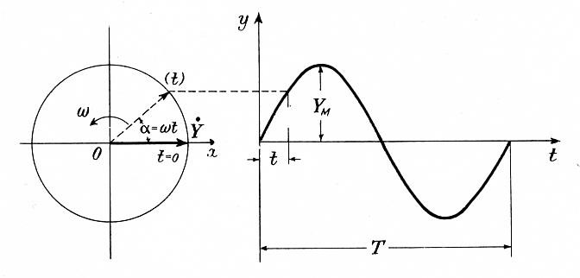
Rappresentazione vettoriale
Consideriamo un generico segnale sinusoidale:
𝑦 = 𝑌_{𝑀}sin(𝜔𝑡 + 𝜑)
Esso può essere immaginato come generato dalla rotazione di un vettore di lunghezza 𝑌_{𝑀}, alla velocità 𝜔.
La sinusoide rappresenta l’andamento dell’ordinata del vettore. Nel caso di 𝜑 = 0 si ha:

Slide 31
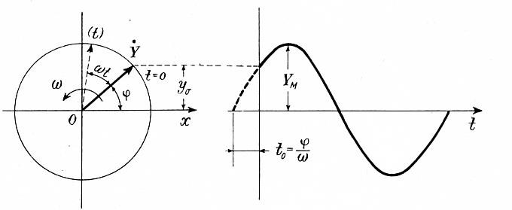
Circuiti resistenze-condensatori in regime sinusoidale
Nel caso di φ≠0 si ha:

Slide 32
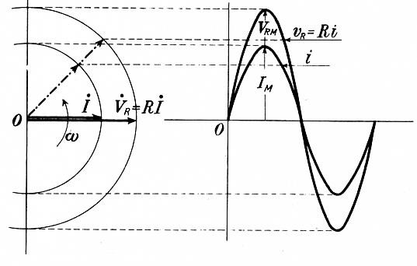
Relazione di fase per un circuito completamente RESISTIVO
Ricordiamoci che in ogni istante, la corrente in un resistore è data dalle legge di Ohm e quindi è direttamente proporzionale alla tensione ai suoi capi.
Perciò, se la tensione è sinusoidale, lo è anche la corrente (con ampiezza determinata da R). Corrente e tensione sono in fase tra loro. Cambia l’ampiezza, ma non la fase e la frequenza o pulsazione

Slide 33
Relazione di fase per un circuito completamente CAPACITIVO
Per un condensatore vale la relazione:
𝑖 = 𝐶 ^{𝑑𝑣}
𝑑𝑡
se 𝑣_{𝑐} = 𝑉_{𝑀} 𝑠𝑖𝑛 𝜔𝑡
𝑑𝑣
𝑐
= 𝜔 𝑉 sin 𝜔𝑡 + ^{𝜋}
𝑑𝑡
𝑀
2
quindi:
𝑖 = 𝜔 𝐶 𝑉 sin 𝜔𝑡 + ^{𝜋}
𝑀
2
Si vede, quindi, che la corrente è ancora sinusoidale, sfasata di un
quarto di periodo e con ampiezza data da:
₌ 𝑉_{𝑀}
𝐼_{𝑀} = 𝜔 𝐶 𝑉_{𝑀}
1
𝜔 𝐶
190

Slide 34
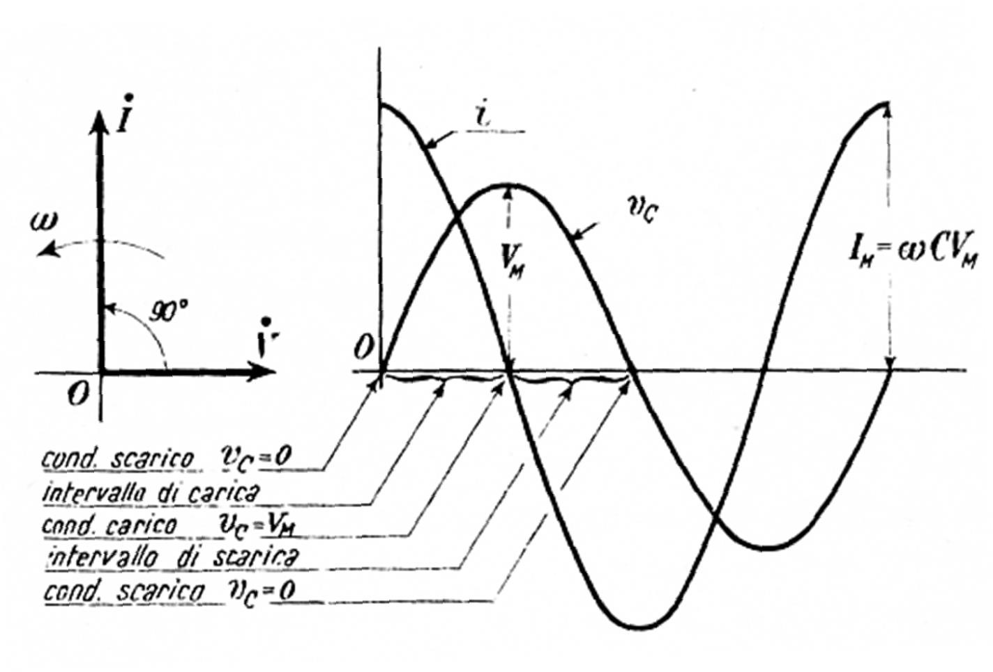
Corrente e tensione in un capacitore possono essere quindi graficati come segue:
Cambia l’ampiezza, cambia la fase NON cambia la frequenza o pulsazione

Slide 35
L’impedenza Z
Possiamo ora definire una nuova grandezza chiamata impedenza e che indicheremo con Z
Questa grandezza lega la tensione alla corrente secondo la relazione V=ZI
Z= Re + jIm
Per un resistore, tale grandezza coincide con il valore della resistenza.
Per un capacitore, utilizzando la relazione appena ricavata prima, si può dire che vale in modulo ¹/_{𝜔𝐶} (chiamata talvolta reattanza capacitiva).
Come numero complesso:
₌ 𝑉_{𝑀}
𝐼_{𝑀} = 𝜔 𝐶 𝑉_{𝑀}
1
𝜔 𝐶
1
^{𝑍𝑐 =} 𝑗𝜔𝐶

Slide 36
L’impedenza Z
In sostanza, quando abbiamo a che fare con un circuito che lavora in regime di tensione o corrente alternata, posso rappresentare le mie grandezze elettriche, tensione e corrente come dei vettori sul piano complesso
Il rapporto tra i due vettori V/I = Z = Re + jIm
È l’impedenza, che è un numero complesso.
La parte reale dell’impedenza è in genere associata ai componenti
dissipativi (resistenze)
La parte immaginaria a quelli che accumulano/rilasciano energia, capacitori e induttori

Slide 37
SPETTROSCOPIA DI IMPEDENZA

Slide 38
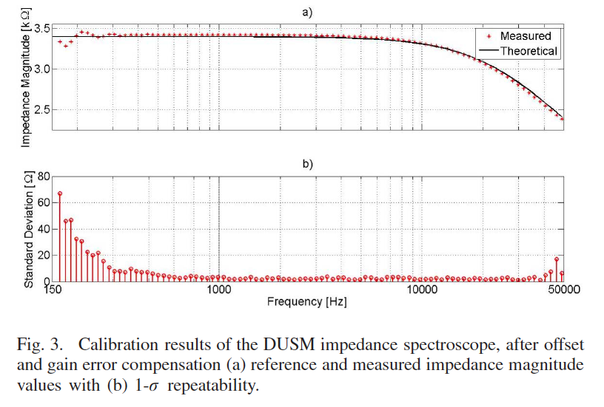

Slide 39
CARATTERISTICHE METROLOGICHE

Slide 40
Ripetibilità: è il grado di concordanza tra una serie di misure di uno stesso misurando (la grandezza oggetto di misurazione), quando le singole misurazioni sono effettuate lasciando immutate le condizioni di misur
Sensibilità: rapporto tra il cambiamento dell'indicazione di un sistema di misura e il corrispondente cambiamento del valore di una grandezza sottoposta a misurazione
Risoluzione: il più piccolo cambiamento della grandezza sottoposta a misurazione che provoca un cambiamento rilevabile nell'indicazione corrispondente

